Slide 1
The Origins of Modern Astronomy:
Astronomy before Copernicus Astro – Chapter 3-1

Slide 2
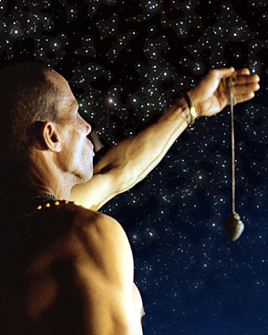
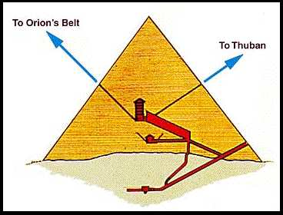
Astronomy as a science dates back thousands of years to ancient Egypt, Greece, and Mesopotamia.
It also originally included Astrology, the telling of fortunes from celestial movements.

Slide 3
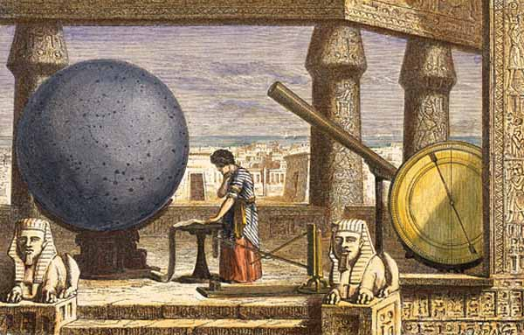
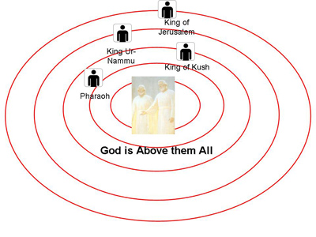
Many astronomers through the years have run into resistance as they proposed ideas that went against the cultural norms, religious beliefs, and the current understanding of Earth’s place in the universe.

Slide 4
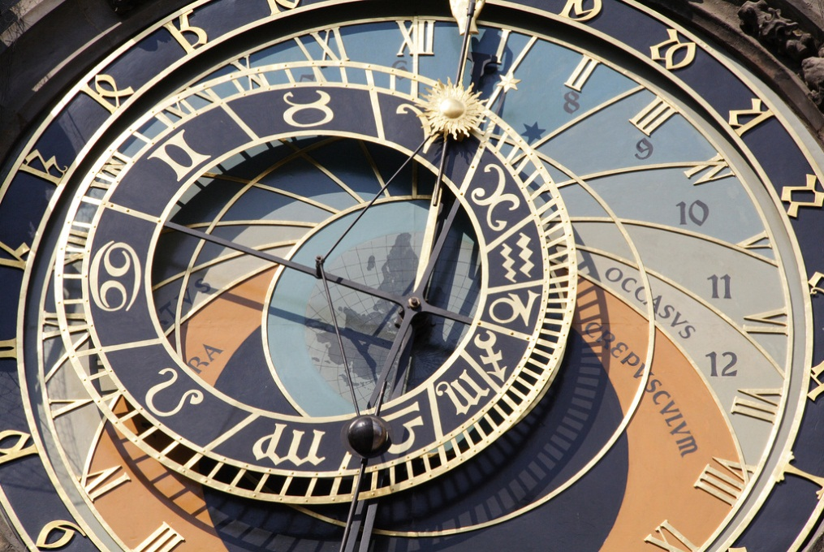
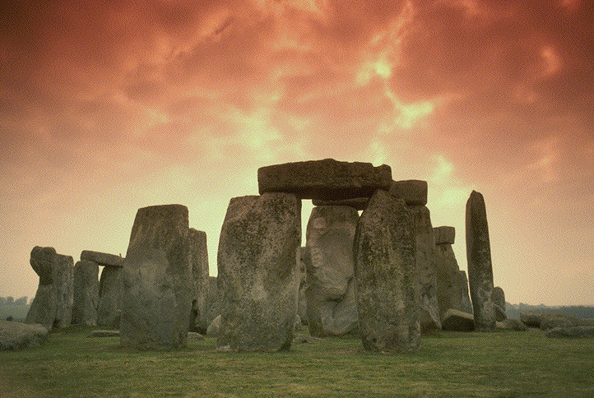
As we continue to study astronomy and gather new information, we encounter our own set of problems, but any new knowledge helps us find our place in the cosmos.
It is always good to see how we got were we are and what steps have been taken along the way.

Slide 5
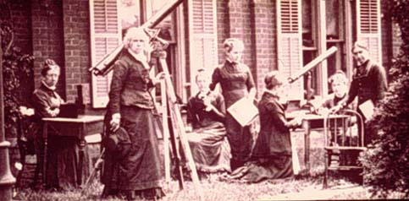
We will look at a few astronomers through history to get a glimpse into some of the most important discoveries, theories and errors in thought.

Slide 6
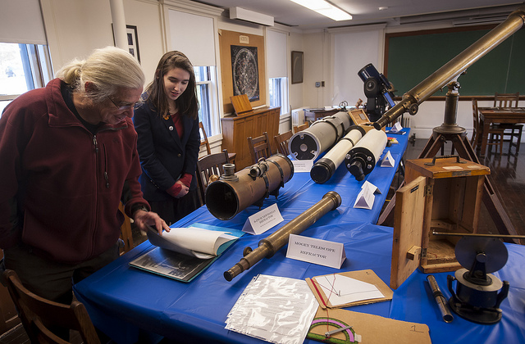
Astronomy before Copernicus
The Copernican model of the universe is used as a major point in the history of astronomy, but we must look back in recorded history before him to see why he was important.

Slide 7
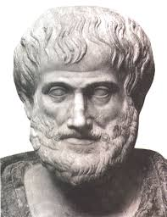
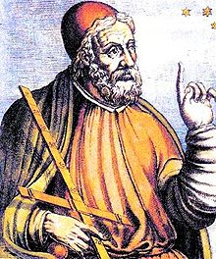
Ancient Greece was the home of 2 of the earliest major astronomers.
1. Aristotle
2. Claudius Ptolemy

Slide 8
Aristotle
Greek philosopher (384-322 B.C.)
It was believed that the heavens were perfect, and since the sphere and circles were the only perfect geometric shapes, the universe must be made of such geometry.
In Aristotle’s day there were three important ideas that existed about the universe.

Slide 9
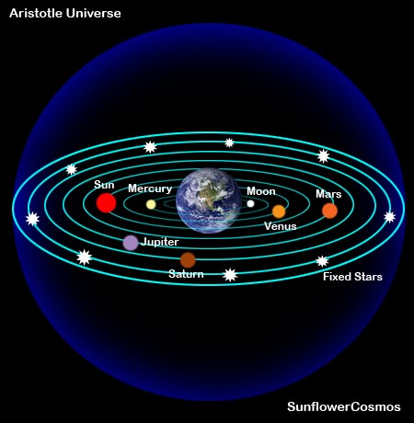
1. The Earth was the center of the universe and everything revolved around it, in circular paths at constant speeds.
→ Geocentric Model
→ Uniform Circular Motion – combinations of
circles turning at
uniform rates

Slide 10
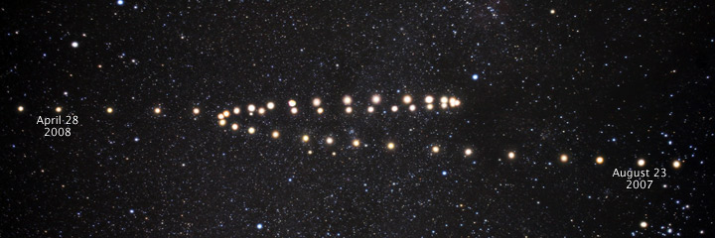
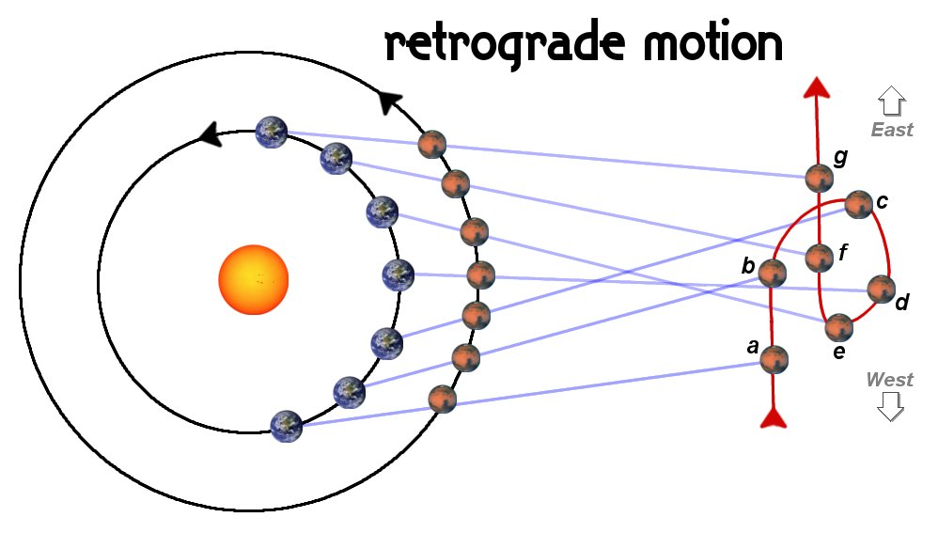
2. As viewed from Earth, planets seemed to follow complicated paths in the sky.
→ Retrograde motion – apparent backwards
motion of a planet

Slide 11
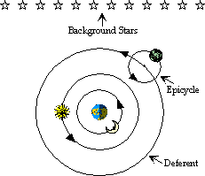
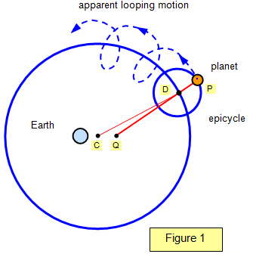
There were uniformly rotating circles rotating around circles.
→ Epicycles and Deferents
→ These were adjusted to account for the
retrograde motion of the planets

Slide 12
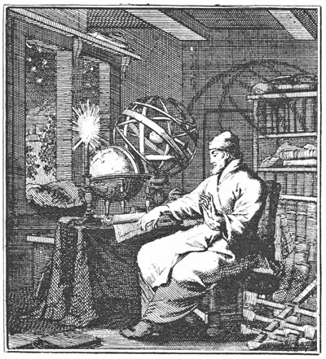
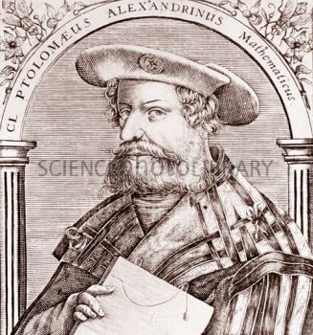
Claudius Ptolemy
Lived 500 years after Aristotle
Was a mathematician interested in accuracy vs. philosophical questioning.

Slide 13
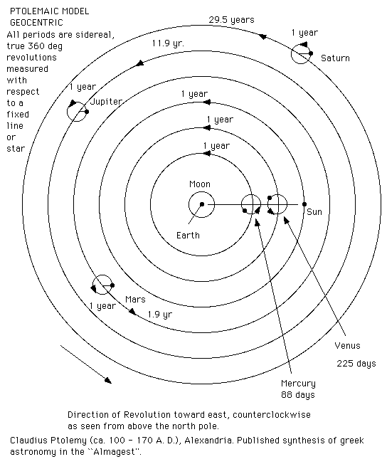
Invented a mathematical model to describe the motions of the planets within Aristotle’s framework.

Slide 14
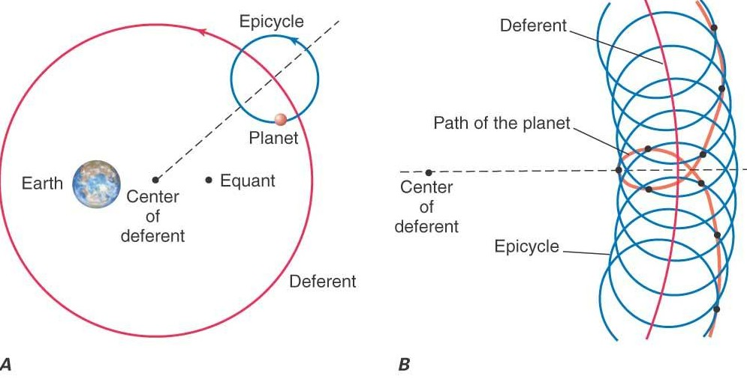
Ptolemy “moved” the Earth a little off center from the axis of rotation of the universe.
This relocation, made possible a bit of variation in the speed at which a planet moved.

Slide 15
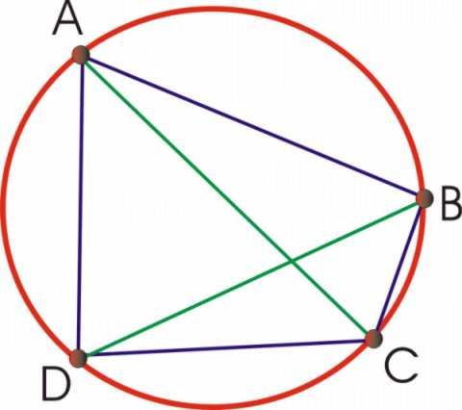
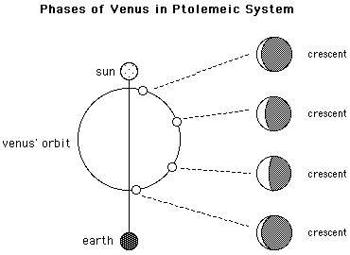
His “adjustment” matched much better with the observed motions.

Slide 16
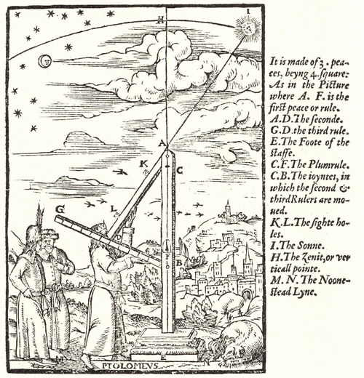
Ptolemy’s model was later updated centuries later to account for accumulated errors over time and adjusted for orbit size and rates of motion.

